Slide 1

IoT-AI Powered Healthcare Network System
Level 1 Architecture: Login & Authentication Module
Team Leads & Members
Supervisors
Harshit Kumar(TL)-MCA(2400680140051)
DR. Brijesh Kumar Gupta (Prof. Dept. of MCA)
Chetan (CL)-MCA(2400680140032)
Mr. Suraj Bhatnagar (B. Tech, M. Tech, CSE IITK)
Atul Tyagi-MCA(2400680140028)
Priyanshu Ahlawat-MCA(2400680140101)
Yashika Rathi-MCA(2400680140146)

Slide 2

Project Title : IOS Mobile Application Development for Affordable and Highly Available IOT-AI Powered Healthcare Network System

Slide 3

Securing the Digital Health Frontier
Criticality of Secure Login
Focus on ironclad security for patient data at the first point of access.
System Architecture
Overview of the Login & Authentication system design.
Kivy & Python
Leveraging Kivy for intuitive iOS UI development.
AI Integration
Using AI for enhanced security and anomaly detection.

Slide 4

Why Secure Login & Authentication Matter in Healthcare IoT
"In healthcare, data isn't just information; it's a patient's story. Protecting that story begins with ironclad security at the very first point of access."
Healthcare IoT devices handle sensitive patient data, demanding robust security measures.
Authentication prevents unauthorized access, ensuring patient safety and data privacy compliance.
The system must be lightweight, scalable, and user-friendly to combine AI and IoT effectively.
Python with Kivy enables rapid, cross-platform development for touch-friendly healthcare apps.

Slide 5



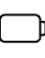

The Challenge: Balancing Access and Security
High Expectations for UI/UX
Must deliver a seamless, intuitive user experience
for healthcare professionals.
Security Challenges
Protecting highly sensitive patient data from
evolving cyber threats.
Performance & Management
Optimizing for performance, memory, and battery life
on mobile devices.
App Store Approval
Navigating the requirements of the iOS App Store.

Slide 6
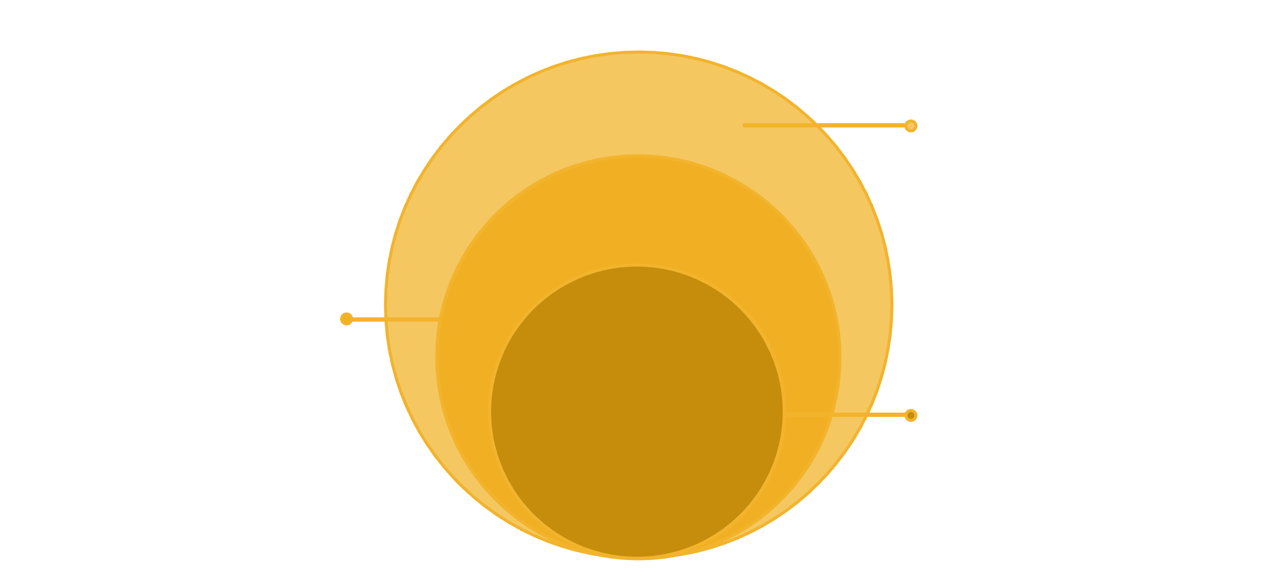
Overview of Level 1 Architecture: Login & Authentication System
Our layered architecture ensures modularity, scalability, and robust security.
The login system is the crucial first line of defense.
Data & IoT Integration
Secure data store and device connectivity
Authentication Logic
Credential validation and token issuance
User Interface
Login screens and session management

Slide 7
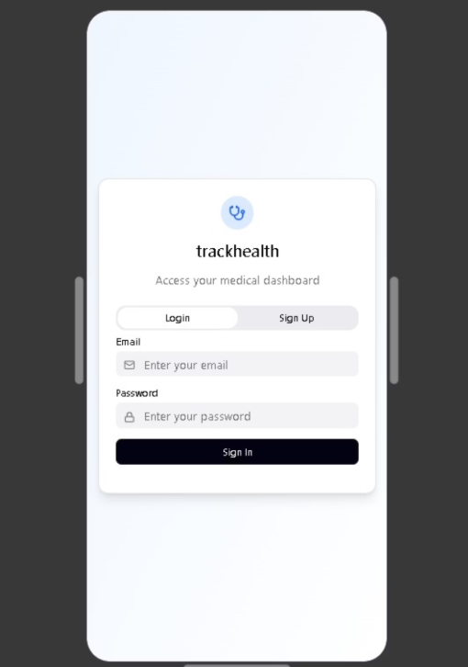


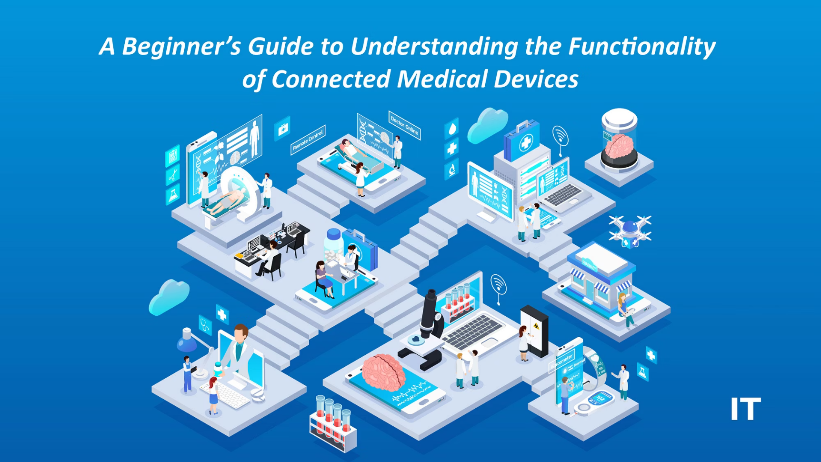
Architectural Layers in Detail
1
2
User Interface Layer
Authentication Logic Layer
Kivy-based GUI handles login/signup screens,
optimized for iOS devices.
Python backend manages credential validation
and secure session management.
Data Layer
IoT Device Integration
Secure communication with Firebase or cloud
database for user data storage.
Ensures only authenticated users can access
connected medical devices
and data streams.
3
4

Slide 8
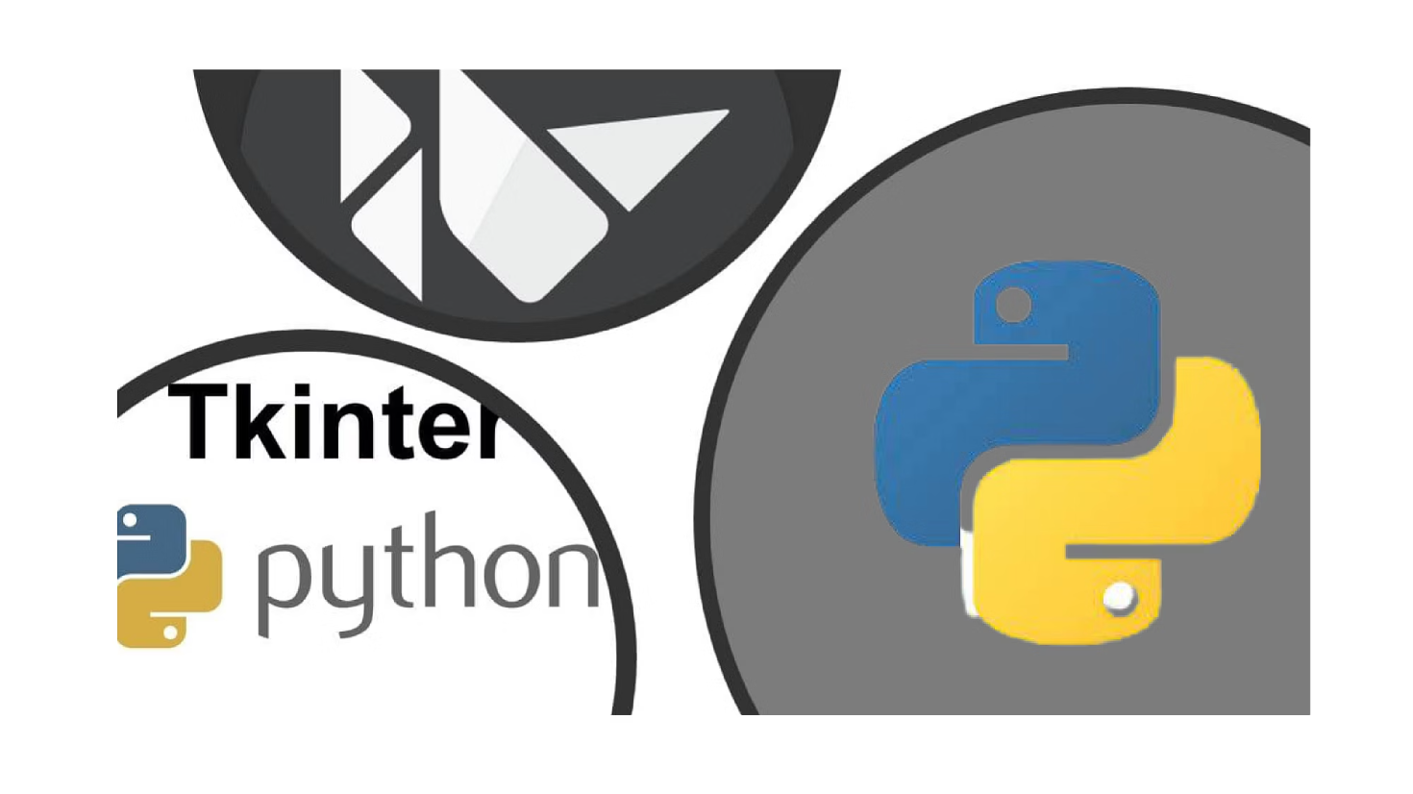
Kivy & Python: The Power Duo for iOS
Python's versatility combined with Kivy's UI capabilities provides a robust, cross-platform development experience for our healthcare application.
Why Kivy is Ideal for Healthcare App UI
Open-source Python library for multi-touch applications.
Supports rapid prototyping and deployment on both iOS and Android.
Enables clean, responsive login/signup screens with real-time validation.
Integrates easily with Python authentication libraries and cloud APIs.

Slide 9






The Authentication Journey: A 6-Step Workflow
Every step is meticulously designed for security, efficiency, and a seamless user experience, with AI playing a key role in proactive threat detection.
Credential Input
Input Validation
Firebase Integration
User enters credentials on the Kivy login screen.
Python backend validates format and strength (e.g., password complexity).
Credentials sent securely to Firebase Authentication service for verification.
Token Generation
Session Management
AI Anomaly Detection
Firebase verifies credentials and returns an authentication token.
On success, a secure user session is created.
AI monitors login patterns for suspicious activity and proactive threat detection.

Slide 10

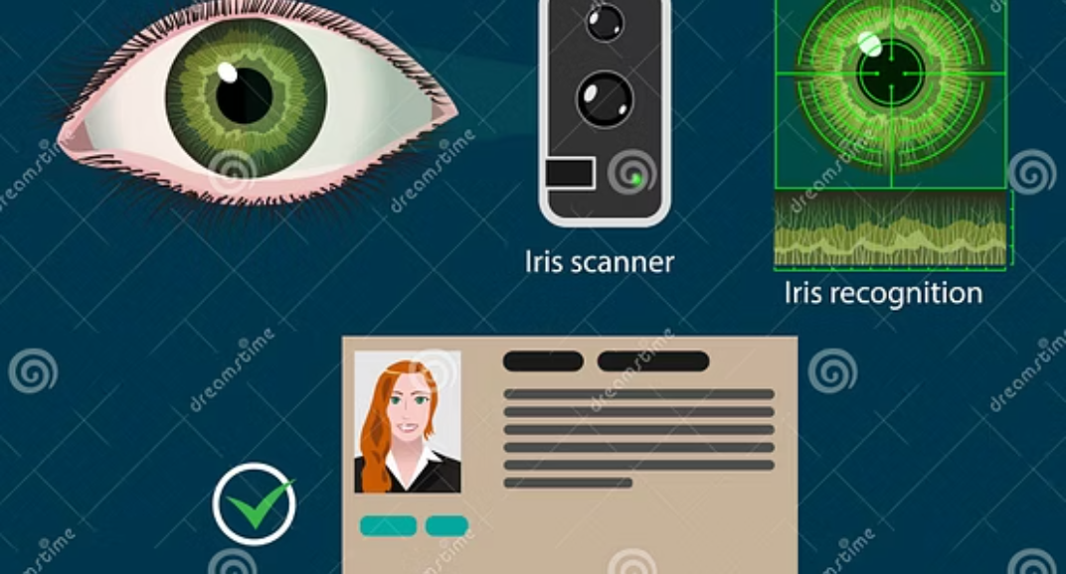
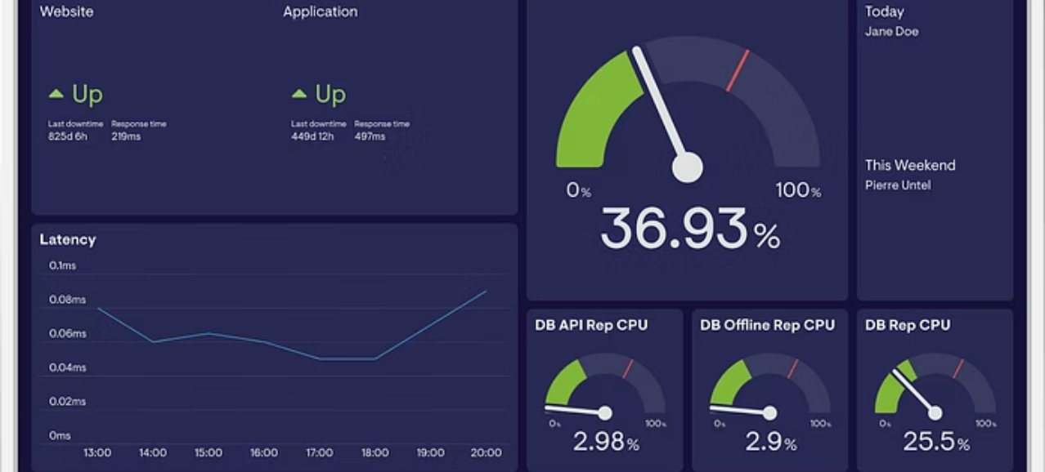
Integrating AI for Enhanced Security
AI is crucial for moving beyond static passwords to dynamic, adaptive security measures
that protect sensitive patient data in real-time.
Behavioral Biometrics: AI analyzes typing speed, swipe patterns, and location data to verify user identity continuously.
Anomaly Detection: Machine learning models flag unusual login times, device changes, or access attempts.
Risk Scoring: Each login attempt is assigned a risk score, triggering multi-factor authentication for high-risk scenarios.

Slide 11
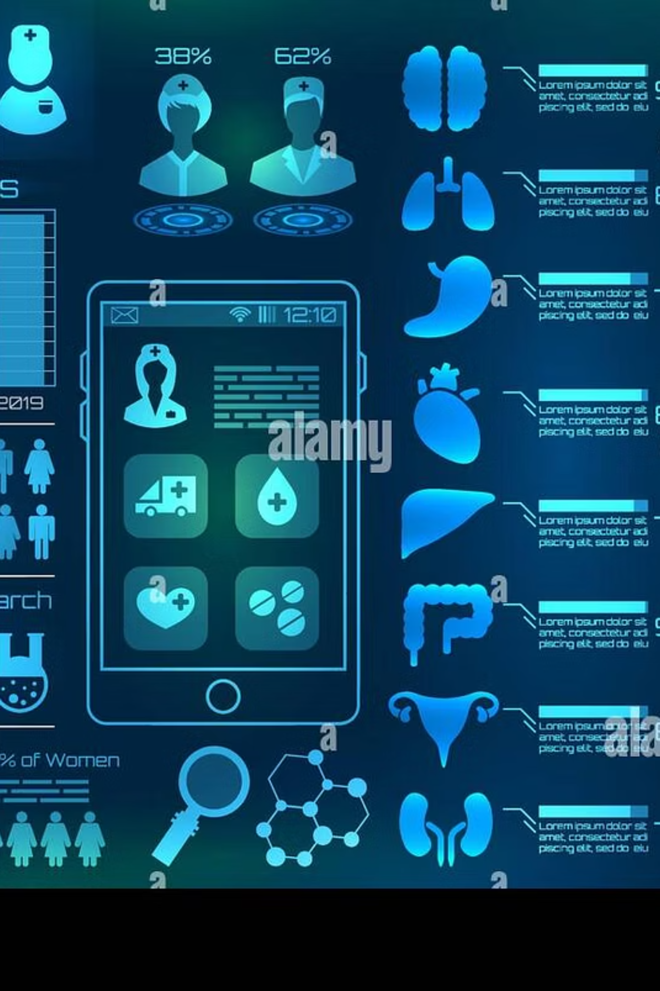
Key Benefits & Future Directions
Secure, Smart, Seamless Healthcare Access
Robust Security
Multi-layered authentication, backed by Firebase and AI anomaly detection, ensures patient data protection.
Cross-Platform Reach
Kivy allows a single codebase for both iOS and Android, maximizing reach and reducing development overhead.
Intuitive UX
Responsive Kivy UI design provides a smooth and efficient
login experience for healthcare professionals.
Future Ready
The modular architecture supports seamless integration
of new IoT devices and advanced AI features.

Slide 12
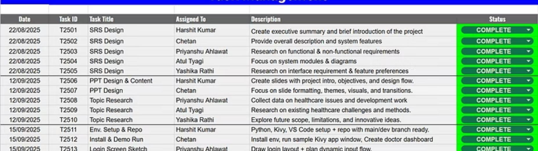
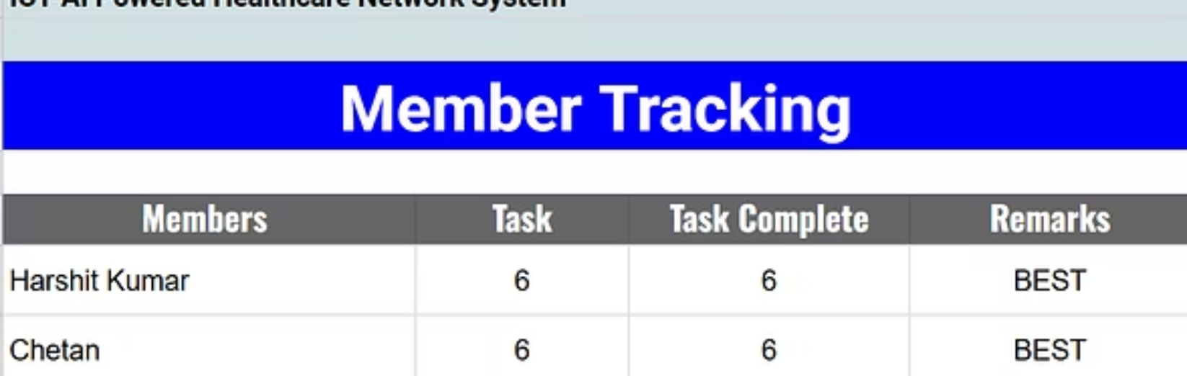
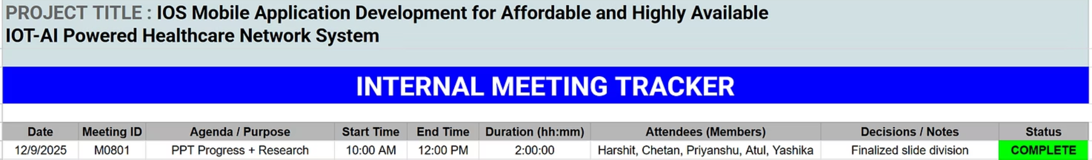
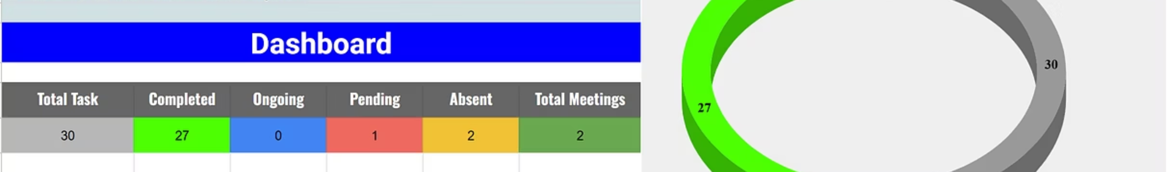
Google Sheet Workflow Management

Slide 13

Thank You!

